Slide 1
Game 1 – Intruder Alert
By Stephan Wells & Erik Scerri
Art by: Youko

Slide 2
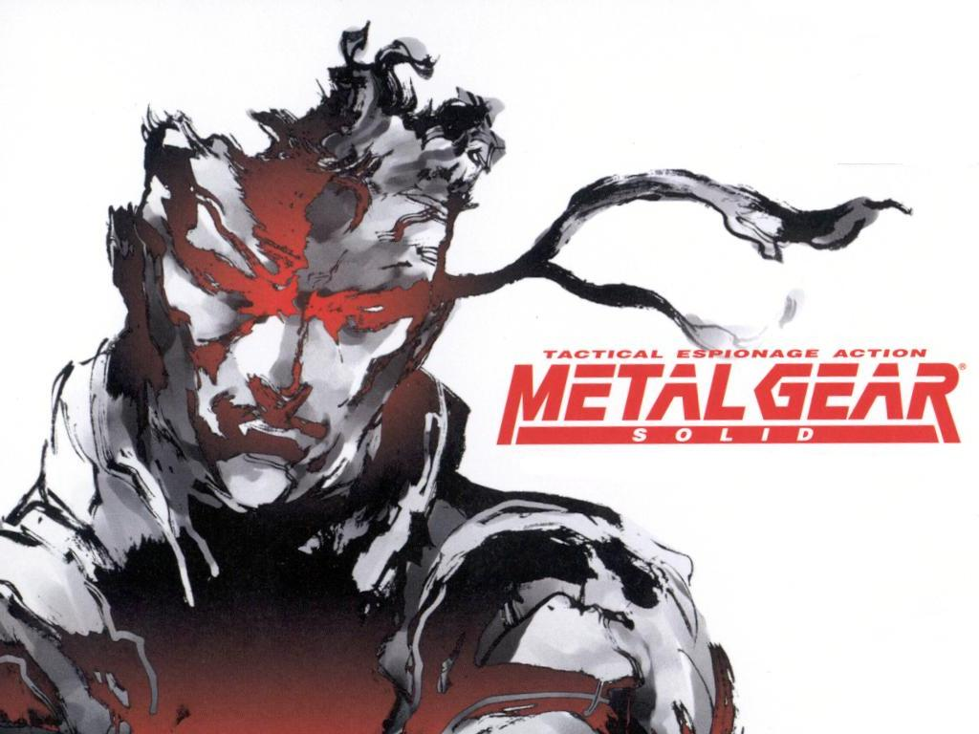
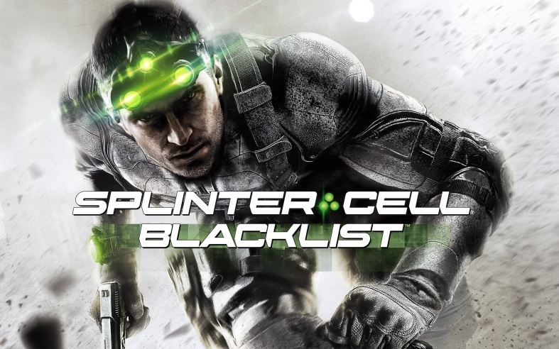
What is a stealth game?
Focus on avoiding combat.
Generally involves getting from Point A to Point B without being seen.
Use of gadgets to reach destination.

Slide 3
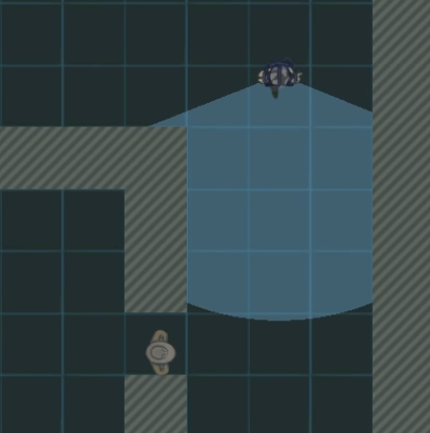
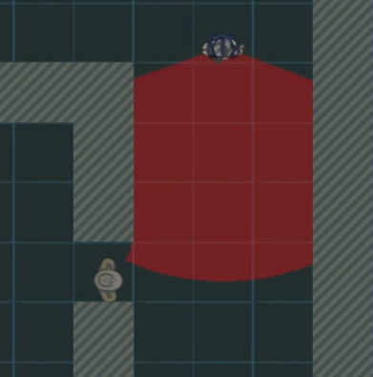
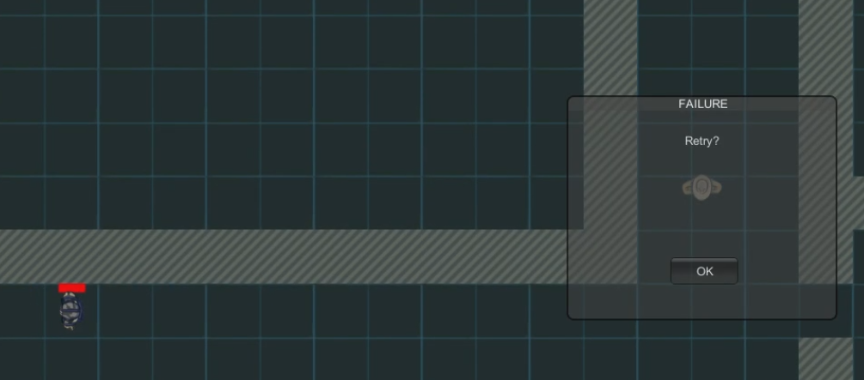
Main Concepts for Our Game
Focus on avoiding combat
When the player is found, the enemy sounds the alarm.

Slide 4
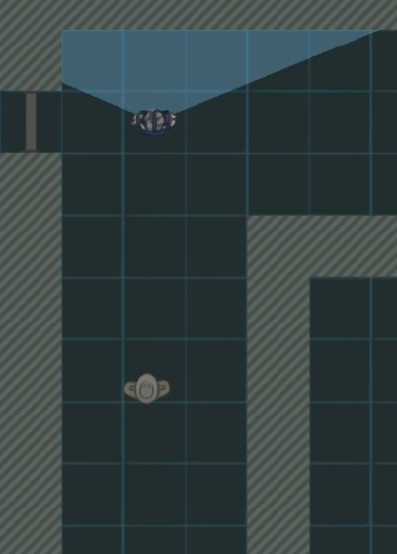
Main Concepts for Our Game
Getting from Point A to Point B
The player must get from the start of the level to the exit door without being seen.

Slide 5
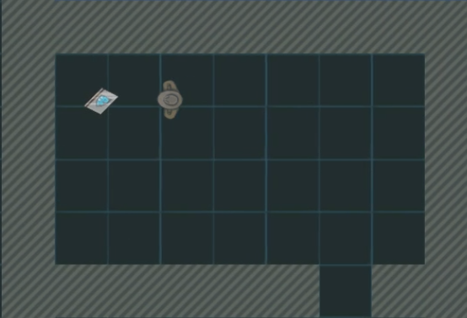
Main Concepts for Our Game
Use of gadgets
There are various items that can be picked up to aid finishing the level.

Slide 6
Game 2 – Rift
By Stephan Wells & Erik Scerri
Art by: Jonah Nolasco

Slide 7


What is a platform game?
Involves obstacles and, more often than not, enemies.
Player character usually has a diverse array of abilities such as double-jump, attacking, etc.

Slide 8
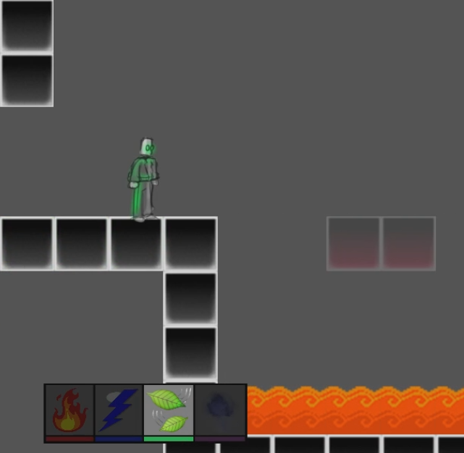
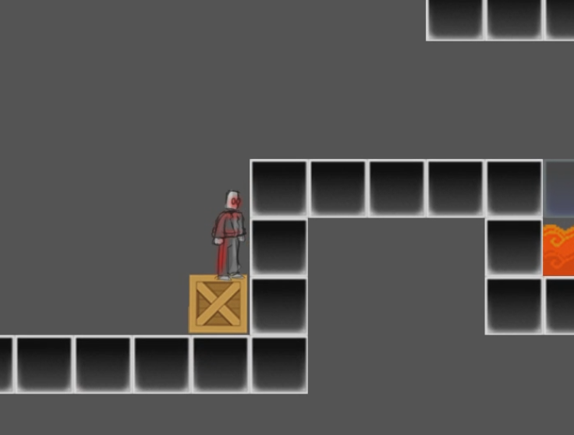
Main Concepts for Our Game
Obstacles
There are various obstacles in the player’s path.

Slide 9
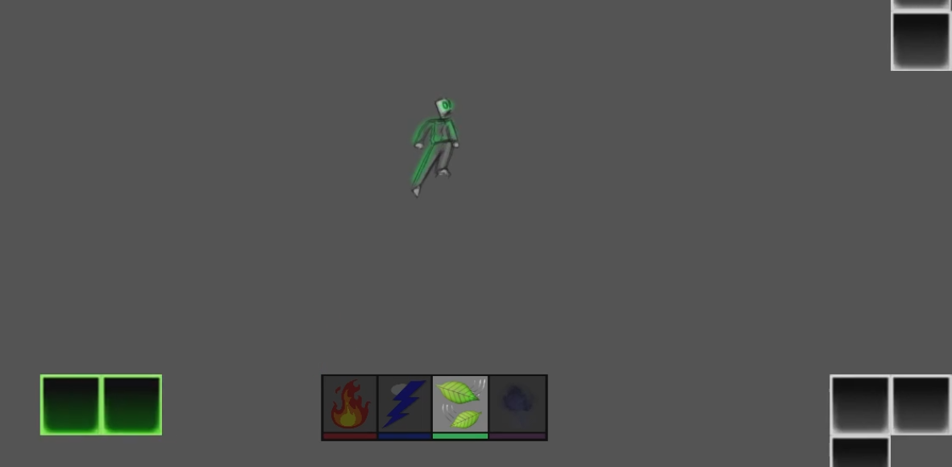
Main Concepts for Our Game
Abilities
The player has access to multiple abilities for fighting and platforming.

Slide 10
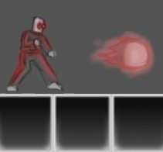
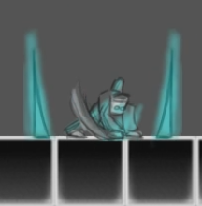
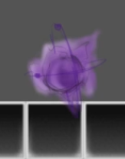
Main Concepts for Our Game
Abilities
The player has access to multiple abilities for fighting and platforming.

